Slide 1
CSCI 567 Pre-Final Check in
Temporally Robust and Fair Credit Risk Prediction
Shree Sriadibhatla, Sadokat Khakimova, Zahra Iranmanesh, Hyeon Ah Jung

Slide 2
Project Recap & Scope Changes
Research Question — unchanged
Research question stayed the same: can credit-risk models stay accurate over time, and are they fair across borrower groups?
What Changed Since Check-in
Metrics and Analysis
Train / Val / Test Split
Evaluation & Metrics
Temporal: train ≤ 2013, val 2014–2015, test ≥ 2016
Random: 70% train / 15% val / 15% test
Added validation set for hyperparameter tuning
→ test set reserved for final evaluation only
→ Random AUC measures performance under the standard random-split benchmark
→ AUC drop = Random AUC minus Temporal AUC, which captures how much performance is lost under temporal shift
Separate temporal and random models are trained
→ separate models trained for temporal and random setups
Preprocessing
→ Yearly AUC trend breaks temporal performance down by year to show whether degradation stays stable or worsens over time.
→ Missing values imputed using medians computed on training data only
→ Feature scaling fit on training set and applied to val/test
→ Fairness groups (income, credit history) defined using training data only
Fairness Analysis
→ We measure FPR, TPR, and PPR across borrower groups to capture different kinds of disparity
Models & Implementation
→ refined Logistic Regression (L2 tuning) and Decision Tree (depth tuning)
→ added and integrated Random Forest and XGBoost into the same pipeline → all models trained with consistent temporal and random setups
→ Evaluated at threshold 0.5 and across multiple thresholds (0.3–0.7)
→ Scompute worst-case threshold-aware disparity across multiple thresholds, since fairness at a single threshold can be misleading.

Slide 3
Model Selection: Random Forest
★ Best Model: RF_n100_d3
n_estimators=100 | max_depth=3 | random_state=42
Why Random Forest
Evaluation Criteria & Scores
Top 3 Random Forest Models by Composite Score
Ensemble of trees reduces variance
→ directly tunable for robustness-fairness tradeoff
Temporal Robustness (AUC Drop ↓)
model | t_auc | drop | acc | fair | score
RF_n100_d3 | 0.6778 | 0.0145 | 0.9158 | 0.0000 | 0.0604
RF_n300_d5 | 0.6794 | 0.0188 | 0.9158 | 0.0179 | 0.0738
RF_n200_d5 | 0.6855 | 0.0072 | 0.8927 | 0.0179 | 0.0776
35%
0.0145
max_depth + min_samples_leaf control overfitting
→ naturally robust to distribution shift
Fairness (worst-case disparity ↓)
40%
0.0000
Search Space
n_estimators
50 / 100 / 200 / 300
Performance (AUC ↑)
Key Insight
max_depth
3 / 5 / 8 / 12 / None
min_samples_leaf
1 / 5 / 20
15%
0.6778
max_features
sqrt/ log2 / 0.5
Shallow depth (d=3) acts as strong regularization, preventing overfitting to training distribution.
RF_n100_d3 achieves the best composite score and the lowest current fairness norm in the final ranking.
ccp_alpha
-
min_impurity
-
Accuracy (↑)
random_state
42
0.9158
10%
→ 17 total models
Composite = 0.35×robustness + 0.4×fairness + 0.15×performance + 0.1×acc
Notes:
4.
For algorithms, we use a range of models with different complexity levels.
This includes logistic regression as a simple baseline, tree-based models like decision trees and random forests, gradient boosting such as XGBoost, and a neural network as a higher-capacity model.
This allows us to compare how model complexity affects robustness and fairness.
For experiments, we design four main analyses.
First, we measure temporal robustness by evaluating how performance degrades over time.
Second, we study how model design choices, such as regularization and complexity, affect both robustness and fairness.
Third, we analyze fairness by comparing error rates across different borrower groups.
Finally, we study the trade-off between robustness and fairness,
and identify which models best balance both.

Slide 4
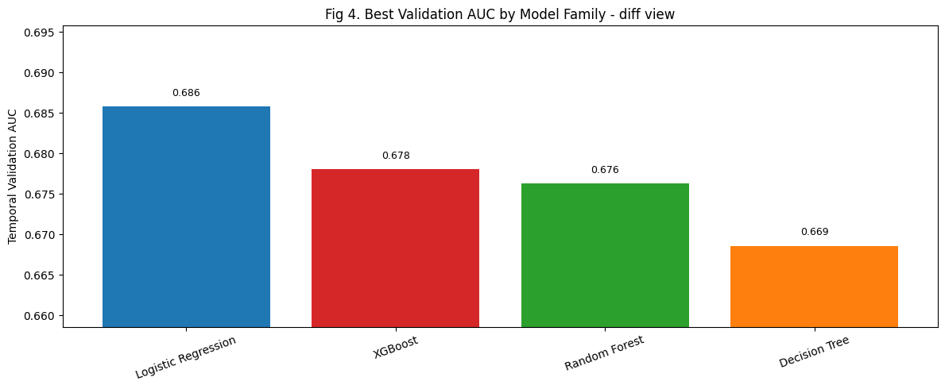
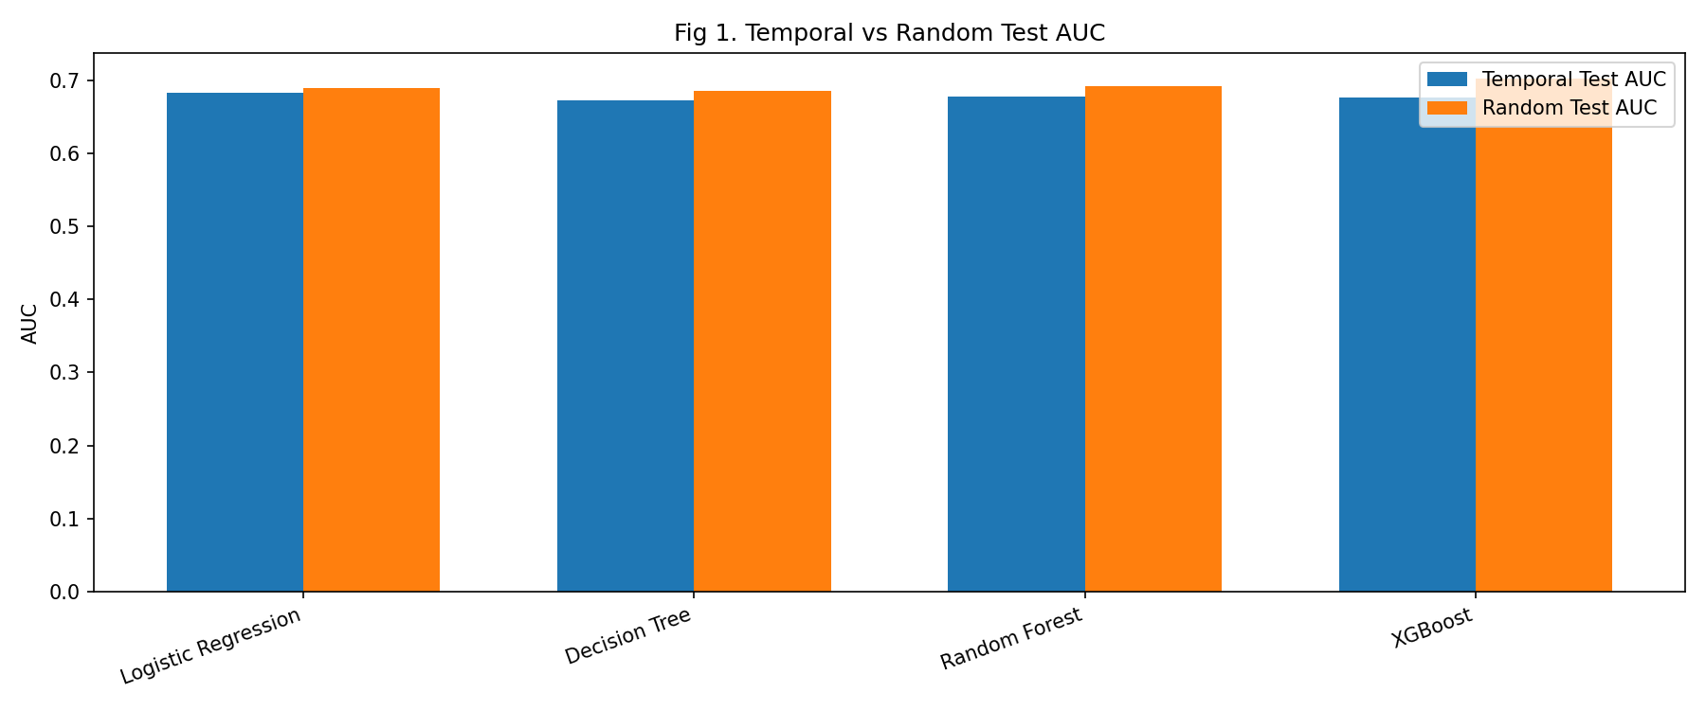
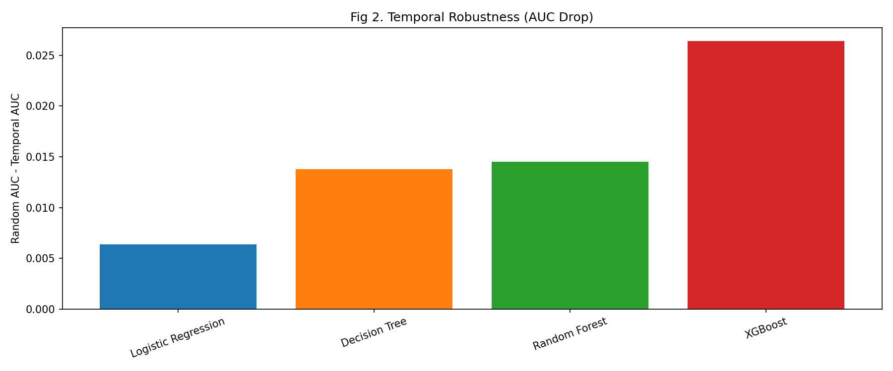
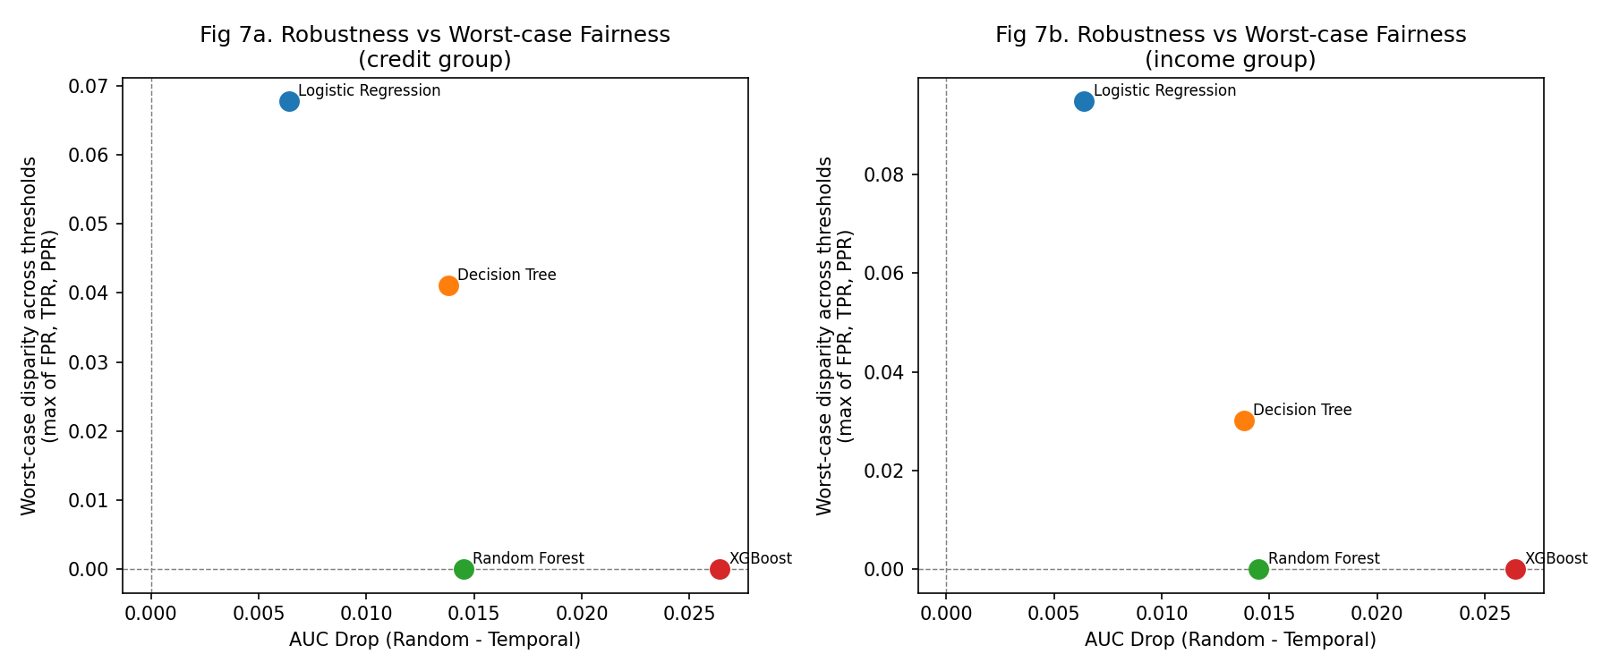
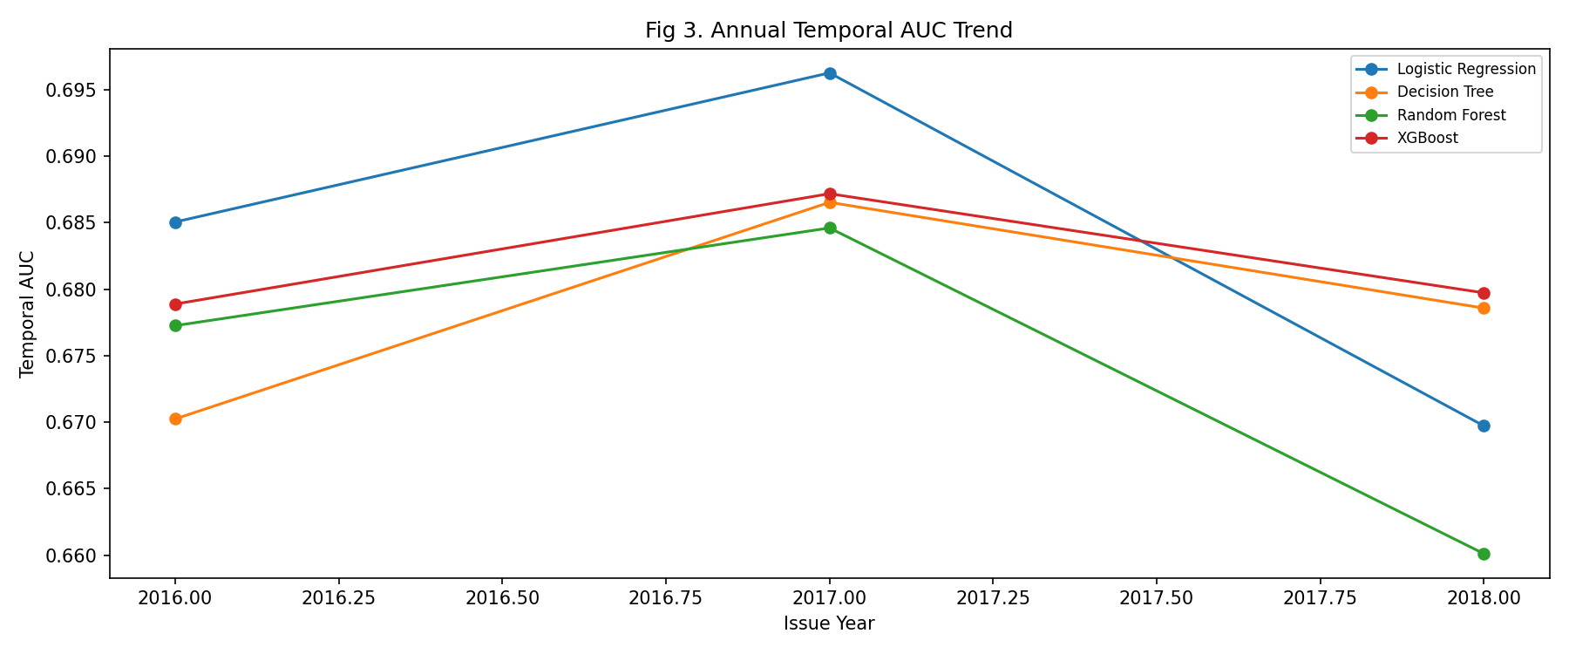
Preliminary Results & Analysis
Fig4. Best Validation AUC by Model Family (Alternative View)
Fig1. Comparing Temporal and Random Test AUC
Fig2. Performance Loss Under Temporal Shift
Fig5. Robustness–Fairness Tradeoff
Fig3. Temporal AUC Over Time
Summary Table. (Representative Models)

Slide 5
Challenges & Solutions
Data Leakage Prevention
Robustness vs Fairness Trade-off
Challenge
Challenge
Preprocessing steps like imputation, scaling, and fairness-group definitions can accidentally use information from validation or test data,
which would make the evaluation overly optimistic
No single model was clearly best on robustness, fairness, and predictive performance at the same time, so choosing a model based on one metric alone was not sufficient
01
03
→ Solution
→ Solution
We fit missing-value imputation, feature scaling, and fairness-group cutoffs on the training split only, then applied the same transformations to validation and test
We compared models using multiple metrics together and used a composite ranking as a practical way to summarize the tradeoff between robustness 35% + fairness 40% + performance 15% + accuracy 10%
Single-Threshold Fairness Was Misleading
Hyperparameter Search Complexity
Challenge
Challenge
Fairness measured only at threshold 0.5 gave an incomplete picture, because some models predicted very few positive cases and therefore appeared artificially fair
A small one-parameter sweep was not enough, because different model families respond to different hyperparameters and their interactions.
02
04
→ Solution
→ Solution
We expanded fairness analysis across multiple thresholds and tracked FPR, TPR, and PPR, then summarized worst-case disparity across thresholds instead of relying only on the default threshold
We built separate tuning sections for Logistic Regression, Decision Tree, Random Forest, and XGBoost, and used validation AUC to choose configurations while keeping the test set only for final evaluation.

Slide 6
Plan for Final Report
Must Complete
If Time Allows
Neural Network Experiments
Re-run on Full Dataset (2.26M)
complete the final planned model family and compare it against current baselines
Validate all results on complete data, again, if time allows
One Focused Extra Analysis
Feature Importance Analysis
either a small ablation or one deeper fairness check, if it clearly strengthens the final story
Identify which features most drive unfairness across credit & income groups
Finalize Results and Figures
Yearly AUC Trend Deep Dive
rerun the final pipeline and lock the main comparison plots/tables
Analyze per-year AUC degradation (2016/2017/2018) by model family
Synthesize Final Conclusions
Performance Improvement
clearly present methodology fixes, key findings, tradeoffs, and limitations and summarize what we learned about temporal robustness and fairness across models
Further hyperparameter tuning to push temporal AUC higher across all models

